Slide 1

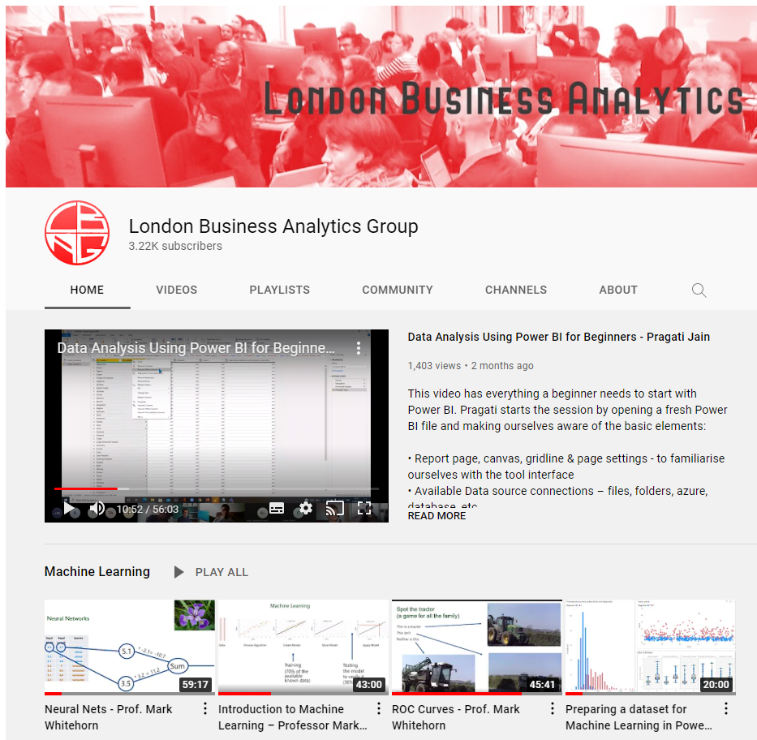
Analysing and Visualising Project Data in Power BI and Excel
London Project Data Analytics Meetup
22nd September 2021
Mark Wilcock MVP
mark.wilcock@zomalex.co.uk
Organiser: London Business Analytics Group

Slide 2
Project data is different from ordinary data.
Project data is different
many more attributes (and fewer quantities)
more qualitative and less quantitative
Rationale for project data – Business questions
When can a project be resourced and start?
What types of resources are available and when?

Slide 3
Power BI Challenges analysing project data
Show the data: so many attributes, so little horizontal space
Different people want different cuts of same data
Some people must have same dataset both in Power BI and Excel
Appealing clear simple visualisations, using standard visual types
Enough dates to drive you crazy

Slide 4
Spoiler – techniques to help with project data
In Power BI
Customise standard (new style) tooltips
Drill-through, often to several pages
Custom tooltips using text boxes and values
Personalisation & bookmarks
Using matrix, conditional formatting for “Gantt chart” style
In Excel (connected to the Power BI dataset)
Linked Datatypes
Pivot Tables

Slide 5
Demo Structure
Excel: Show and explain fictitious sample dataset
Power BI Desktop on worked example
Project Pipeline page (tooltips, drill-through, bookmarks)
Project “Gantt” pages (underpinning DAX and data model, conditional formatting: bars & icons & colours)
Data Model: prep for linked data in ..
Excel (linked data and pivot tables)
Power BI Service (personalisation)

Slide 6
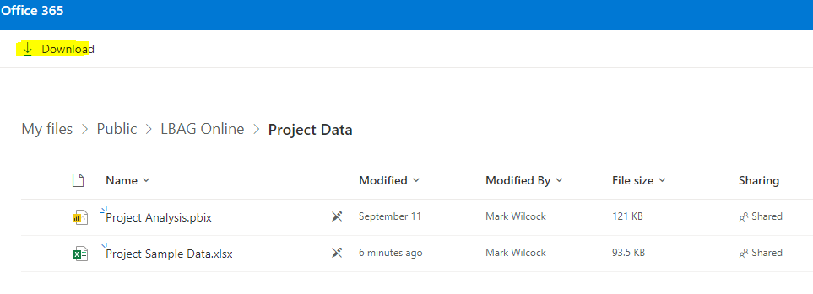
Demo resources available
On public OneDrive
Sample Data (Excel)
Power BI Desktop File – worked example
Really soon now!
Sample data on github
Videos on YouTube London Business Analytics Group channel (Project Data playlist)

Slide 7
User Training is Essential
Consuming data & reports is not a passive activity
Report viewers need to know
filters and slicing
Report and personal bookmarks
Personalisation
How to use Excel linked data and pivot tables
and be data savvy…

